Slide 1
Python Language
John Wang Ph.D.
Notes:
What is the computer language background for each student?
what kind of language they have learned before?
what is the computer skill about how to using computer?
surfer on the internet? find what they want to know, learn what they want to learn?
Let student find Python keyword on internet.

Slide 2
What we will learn in this class?
Install Python Development Package;
Install Visual Code;
Learn how to use Visual Code to do Python programing;
Install GIT source control;
Learn how to use GIT to manage your source code changes;
Learn how to save your work on internet (Github)
Learn Markdown document, and use it for learning notes;
Install Java JDK;
Install Eclipse;
Install Eclipse and PyDev;
Learn how to use Eclipse to write Python code;
What is Python?
Will give you a good idea of the language’s flavor and style;
Basic syntax;
Use file to write Python code;
Read from & Write to file;
Exception and Error handling;
After this course, you may be able to continue learn Python all by yourself.

Slide 3
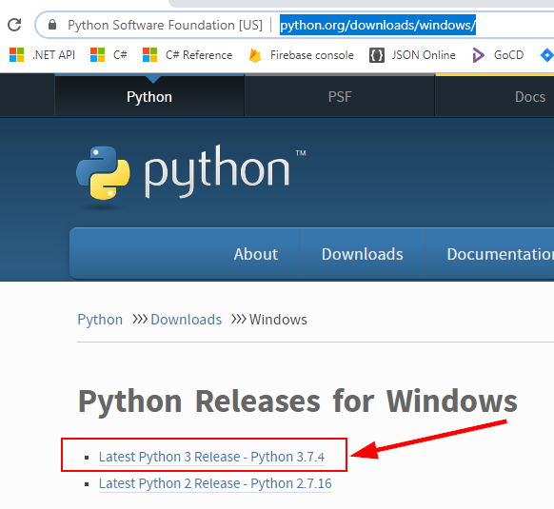
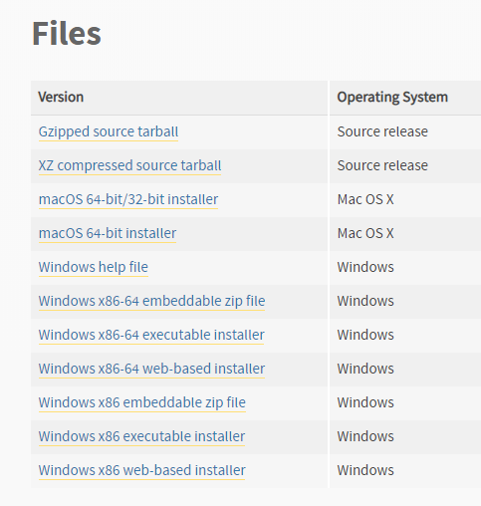
Download Python
https://www.python.org/downloads/windows/
Download installation file: python-3.7.4-amd64.exe
Notes:
check to see if you already have Python installed.
python

Slide 4
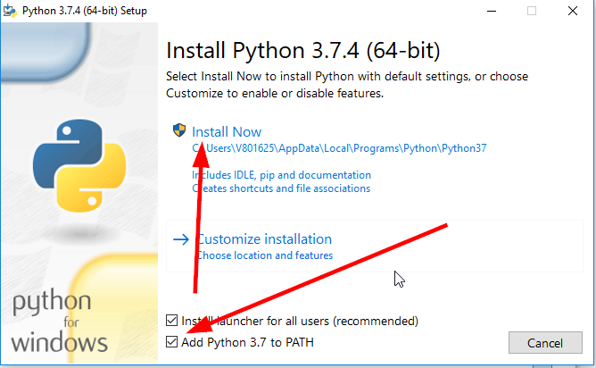
Install Python
After successfully installed, check the installation:
C:\> python --version
Notes:
Online tutorial
After installation, check it
>python
C:\Users\V801625>python
Python 3.7.4 (tags/v3.7.4:e09359112e, Jul 8 2019, 20:34:20) [MSC v.1916 64 bit (AMD64)] on win32
Type "help", "copyright", "credits" or "license" for more information.
https://docs.python.org/3.7/tutorial/index.html
Document
https://docs.python.org/3.7/index.html

Slide 5
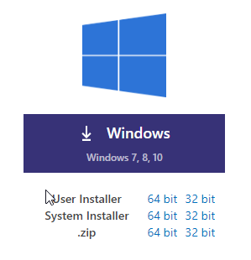
Download and Install Visual Studio Code
https://code.visualstudio.com/download
VSCodeSetup-x64-1.37.1.exe
After successful installation, check the installation
Notes:
Visual Studio Code
very good tutorial for VSCode for Python
https://www.youtube.com/watch?v=06I63_p-2A4
For Windows
https://www.youtube.com/watch?v=-nh9rCzPJ20&t=2066s

Slide 6
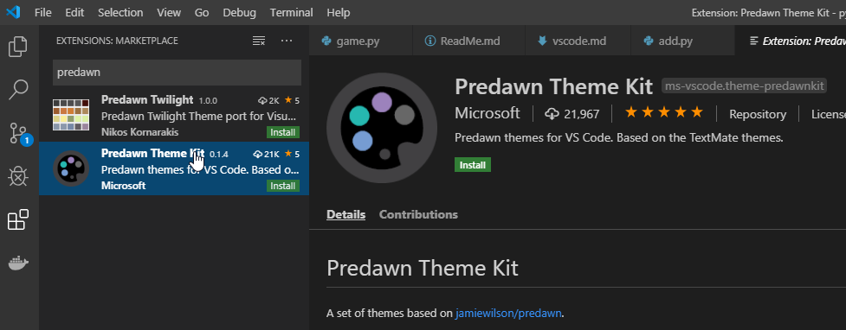
Visual Studio Code Theme
Notes:
Extension
Predawn

Slide 7
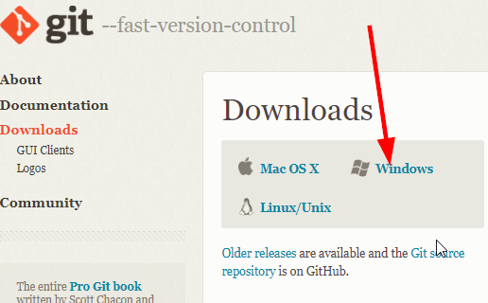
Download and Install Git
Download Git source control software:
https://git-scm.com/downloads
1. Install Git
2. Check the installation
Apply for Github account
https://help.github.com/en/articles/about-github-education-for-students
Create a new repository
Add document into the repository

Slide 8
What is Python?
Python It has efficient high-level data structures and a simple but effective approach to object-oriented programming (OOP).
Script Language (interpreted);
Standard library are freely available;
Free third party Python modules;
Can be used for Game, GUI;
Platform independent;
It has high level data types built in (flexible arrays, dictionaries);
Python allow you split your program into modules that can be reused in other Python programs.
Source code are much shorter than equivalent C, C++ or Java programs.
Notes:
the usual write/compile/test/re-compile cycle is too slow
Best way to learn something new is to try it
https://docs.python.org/3/tutorial/
The Python Standard Library
https://docs.python.org/3/library/index.html#library-index
The Python Language Reference
https://docs.python.org/3/reference/index.html#reference-index
Extending and Embedding the Python Interpreter
https://docs.python.org/3/extending/index.html#extending-index

Slide 9
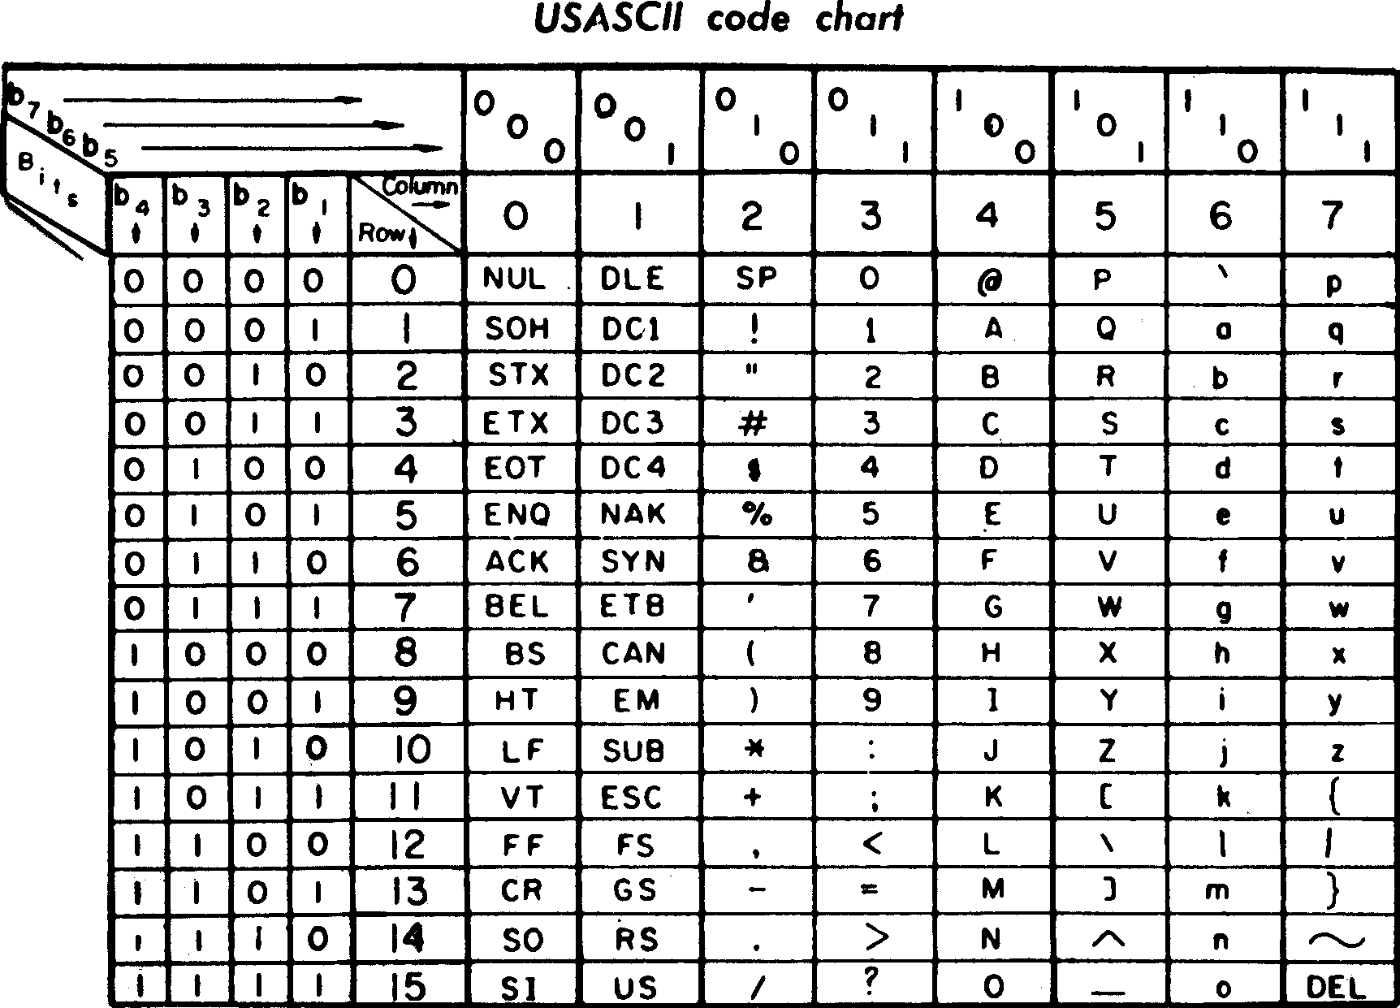
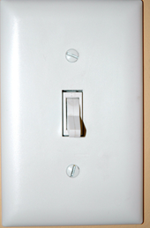
American Standard Code for Information Interchange
Notes:
ASCII: American Standard Code for Information Interchange
A: 0100 0001 == x41
>>>0x41
>>>0b1000001

Slide 11
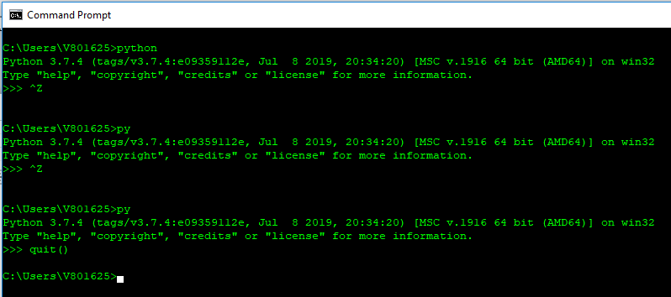
3+4
a=5
b=6
a+b
print(“Hello, the World!”)
Do it by yourself:

Slide 12
Python operators
=
<
+, -, *, /
_
Language Basic
>>> a, b = 0, 1
>>> while a<10:
... print( a +b)
... a ,b = a + 1, a + b
...
Python reserved key words
while
If
elif
for
in
>>> tax = 12.5 / 100
>>> price = 100.5
>>> price * tax
12.5625
>>> price + _ # where _ represent the result of previous value
113.0625
>>> round(_,2)
113.06
>>>
Predefined functions
print()
round()
rang()
Notes:
year = 2019
if year==2019

Slide 13
Get Input from user
>>> input("Please enter your name: ")
>>> x = input("Please enter your name: ")
>>> print('Hello, {}'.format(x))
>>> print("Hello, %s!" % x)
>>> n = input("Please enter a number: ")
Please enter a number: 5
>>> n = int(n)
>>> 5+n

Slide 14
If condition
>>> x=int(input("Please enter an integer: "))
Please enter an integer: 30
>>> if x < 0:
... x=0
... print("Negative changed to zero")
... elif x==0:
... print("Zero")
... elif x==1:
... print("Single")
... else:
... print("More")
...
More
>>>
Flow Control
>>>you_are_a_student = True
>>>if you_are_a_student:
… print(“I am a student”)
…
I am a student.

Slide 15
“for” loop
>>> words=["cat", "window", "door", "dog"]
>>> for w in words:
... print(w, len(w))
...
cat 3
window 6
door 4
dog 3
>>> for n in range(2, 10):
... for x in range(2, n):
... if n % x == 0:
... print(n, 'equals', x, '*', n//x)
... break
... else:
... print(n, 'is a prime number')
...

Slide 16
“while” loop
count = 0
while count < 5:
print(count)
count += 1
“break” and “continue”
count = 0
while True:
print(count)
count += 1
if count >= 5:
break
for x in range(10):
if x % 2 == 0:
continue
print(x)

Slide 17
Defining Functions
where,
>>> def fib(n):
... a, b=0,1
... while a < n:
... print(a, end=' ')
... a, b = b, a+b
... print()
...
>>> fib(100)
0 1 1 2 3 5 8 13 21 34 55 89
>>>
Key word | Description
def | Definition, language key word
fib | Function name, you name it
(n) | Variable argument n, must be inside the ()
: | Syntax, don’t miss it, or error out, next line must indent
Rest | Function body
After you define a function, you can call it, or execute it.

Slide 18
Using script file
Create a file named fiblib.py
def fib(n):
a, b = 0, 1
while a < n:
print(a, end=' ')
a, b = b, a + b
print()
def fib2(n):
result = []
a, b = 0, 1
while a < n:
result.append(a)
a, b = b, a+b
return result
>>> import fib
>>> fib.fib(1000)
0 1 1 2 3 5 8 13 21 34 55 89 144 233 377 610 987
>>> fib.fib2(1000)
[0, 1, 1, 2, 3, 5, 8, 13, 21, 34, 55, 89, 144, 233, 377, 610, 987]
>>> quit()
>>> from fib_lib import *
>>> fib(500)
0 1 1 2 3 5 8 13 21 34 55 89 144 233 377
>>> fib2(500)
[0, 1, 1, 2, 3, 5, 8, 13, 21, 34, 55, 89, 144, 233, 377]
>>>

Slide 19
>>> import builtins
>>> dir(builtins)
['ArithmeticError', 'AssertionError', 'AttributeError', 'BaseException', 'BlockingIOError', 'BrokenPipeError', 'BufferError', 'BytesWarning', 'ChildProcessError', 'ConnectionAbortedError', 'ConnectionError', 'ConnectionRefusedError', 'ConnectionResetError', 'DeprecationWarning', 'EOFError', 'Ellipsis', 'EnvironmentError', 'Exception', 'False', 'FileExistsError', 'FileNotFoundError', 'FloatingPointError', 'FutureWarning', 'GeneratorExit', 'IOError', 'ImportError', 'ImportWarning', 'IndentationError', 'IndexError', 'InterruptedError', 'IsADirectoryError', 'KeyError', 'KeyboardInterrupt', 'LookupError', 'MemoryError', 'ModuleNotFoundError', 'NameError', 'None', 'NotADirectoryError', 'NotImplemented', 'NotImplementedError', 'OSError', 'OverflowError', 'PendingDeprecationWarning', 'PermissionError', 'ProcessLookupError', 'RecursionError', 'ReferenceError', 'ResourceWarning', 'RuntimeError', 'RuntimeWarning', 'StopAsyncIteration', 'StopIteration', 'SyntaxError', 'SyntaxWarning', 'SystemError', 'SystemExit', 'TabError', 'TimeoutError', 'True', 'TypeError', 'UnboundLo, 'TypeError', 'UnboundLocalError', 'UnicodeDecodeError', 'UnicodeEncodeError', 'UnicodeError', 'UnicodeTrlatEcodeWarningWarning''VanslateError', 'UnicodeWarning', 'UserWarning', 'ValueError', 'Warning', 'WindowsError', 'ZeroDivisionErro_bud, '__doc__''__loade,r', '__build_class__', '__debug__', '__doc__', '__import__', '__loader__', '__name__', '__package__', '__sabs'l', 'breakpes', 'ca',pec__', 'abs', 'all', 'any', 'ascii', 'bin', 'bool', 'breakpoint', 'bytearray', 'bytes', 'callable', 'chr'od'odelattr', 'te', 'evec, 'classmethod', 'compile', 'complex', 'copyright', 'credits', 'delattr', 'dict', 'dir', 'divmod', 'enumerexeer', 'globald', 'inp,ate', 'eval', 'exec', 'exit', 'filter', 'float', 'format', 'frozenset', 'getattr', 'globals', 'hasattr', 'x', e', 'list',ext', 'o',hash', 'help', 'hex', 'id', 'input', 'int', 'isinstance', 'issubclass', 'iter', 'len', 'license', 'list', ', vy', 'quit', 'slice'ta
'locals', 'map', 'max', 'memoryview', 'min', 'next', 'object', 'oct', 'open', 'ord', 'pow', 'print', 'prop'rever', 'tupleerty', 'quit', 'range', 'repr', 'reversed', 'round', 'set', 'setattr', 'slice', 'sorted', 'staticmethod', le'
'str', 'sum', 'super', 'tuple', 'type', 'vars', 'zip']
>>>

Slide 20
Create a file named: age.py
def myage(birthYear):
thisYear = 2019
print('My age is ', (thisYear - birthYear))
>>> import age
>>> age.myage(2000)
My age is 19
>>>
Do It by Yourself:
Convert Celsius to Fahrenheit: (Fahrenheit – 32) * 5/9 = Celsius

Slide 21
Input and Output
>>> for x in range(1, 11):
... print('{0:2d} {1:3d} {2:4d}'.format(x, x*x, x*x*x))
...
1 1 1
2 4 8
3 9 27
4 16 64
5 25 125
6 36 216
7 49 343
8 64 512
9 81 729
10 100 1000

Slide 22
Read from a File
>>> with open('age.py') as f:
... for line in f:
... print(line, end='')
...
Do It by Yourself:
create a text file;
display the content using Python.

Slide 23
Write to a File
>>> with open(‘add.py', 'w+') as f:
... f.write('print(a + b)\n')
...
11
>>>
Do It by Yourself:
create a text file;
write something to the file using Python.

Slide 24
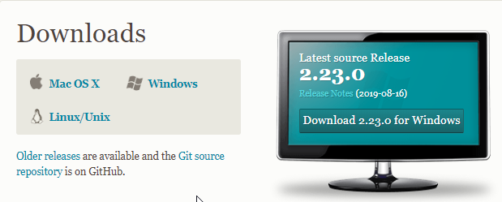
Download Git
Do It by Yourself:
find GIT software on internat;
download it on you hard disk;
install the software;
make sure the software installed correctly

Slide 25
Git Repository
C:\Users\V801625\workspace\python>git init
Initialized empty Git repository in C:/Users/V801625/workspace/python/.git/
C:\Users\V801625\workspace\python>git add --all
C:\Users\V801625\workspace\python>git commit -m "first commit"
[master (root-commit) 01d45f7] first commit
5 files changed, 26 insertions(+)
create mode 100644 add.py
create mode 100644 age.py
create mode 100644 fib.py
create mode 100644 fib_lib.py
create mode 100644 test.txt
C:\Users\V801625\workspace\python>git log --oneline
01d45f7 (HEAD -> master) first commit

Slide 26
Append to a File
Available file operation:
open()
close()
read()
write()
closed()
readline()
seek()
>>> with open(‘add.py', ‘a+') as f:
... f.write('print(a + b)\n')
...
11
>>>
>>> with open ('add.py') as f:
... for line in f:
... print(line, end='')
Do It by Yourself:
add more Python code into existing file;
test the file by executing it;
display all contents in the file by Python (for loop);
search on internet, find how to use ‘w’, ‘a’, ‘r’, ‘b’, ’w+’ and so on.
Notes:
Mode Description
'r’ This is the default mode. It Opens file for reading.
'w’ This Mode Opens file for writing. If file does not exist, it creates a new file. If file exists it truncates the file.
'x’ Creates a new file. If file already exists, the operation fails.
'a’ Open file in append mode. If file does not exist, it creates a new file.
't’ This is the default mode. It opens in text mode.
'b’ This opens in binary mode.
'+’ This will open a file for reading and writing (updating)

Slide 27
Mode Description
'r’ This is the default mode. It Opens file for reading.
'w’ This Mode Opens file for writing. If file does not exist, it creates a new file. If file exists it truncates the file.
'x’ Creates a new file. If file already exists, the operation fails.
'a’ Open file in append mode. If file does not exist, it creates a new file.
't’ This is the default mode. It opens in text mode.
'b’ This opens in binary mode.
'+’ This will open a file for reading and writing (updating)

Slide 28
Format output string
Placeholder | Variable
%s | name
>>> name = "John"
>>> print("Hello, %s!" % name)
>>> name = "John"
>>> print("Hello, %s!", name)
>>> name="John"
>>> age=23
>>> print("%s is %d years old." % (name, age))
Do It by Yourself:
display your own name and age on the screen.

Slide 29
Format output string
%s - String (or any object with a string representation, like numbers)
%d - Integers
%f - Floating point numbers
%.<number of digits>f - Floating point numbers with a fixed amount of digits to the right of the dot.
%x/%X - Integers in hex representation (lowercase/uppercase)
Do It by Yourself:
display your own data follow the above instruction on the screen.
a + b = 30
Finish the following code,
Print the following on the screen
data = ("John", "Doe", 53.44)
format_string = "Hello“
print(format_string % data)
Hello John Doe. Your current balance is $53.44.
Notes:
print("PI = %.4f" % 3.1415926)
print("PI = %f" % 3.1415926)
print("PI = %.2f" % 3.1415926)
print("65 = x%x" % 65)
>>> data=("John", "Doe", 53.44)
>>> format_string = "Hello %s %s. Your current balance is $%.2f.“
>>> print(format_string % data)

Slide 30
Format output string
s = "Hey there! what should this string be?“
# Length should be 20
print("Length of s = %d" % len(s))
# First occurrence of "a" should be at index 8
print("The first occurrence of the letter a = %d" % s.index("a"))
# Number of a's should be 2
print("a occurs %d times" % s.count("a"))
# Slicing the string into bits
print("The first five characters are '%s'" % s[:5])
# Start to 5
print("The next five characters are '%s'" % s[5:10])
# 5 to 10
print("The thirteenth character is '%s'" % s[12])
# Just number 12
print("The characters with odd index are '%s'" %s[1::2])
#(0-based indexing)
print("The last five characters are '%s'" % s[-5:])
# 5th-from-last to end# Convert everything to uppercase
print("String in uppercase: %s" % s.upper())

Slide 31
JSon
>>> with open ('test.txt', 'w+') as f:
... json.dump([1, 'simple', 'list'], f)
...
>>>
>>> with open ('test.txt', 'w+') as f:
... json.dump({'student':{'firstName':'John', 'lastName':'Wang', 'id':123456}}, f)
...
>>>
Do It by Yourself:
create complicated json file found on internet to a file;
display the content on the screen.
>>> import json
>>> with open ('widget.json') as f:
... x = json.load(f)
... print(x)
...

Slide 32
Error and Exception
>>> while True print("Hello world")
File "<stdin>", line 1
while True print("Hello world")
^
SyntaxError: invalid syntax
>>>
>>> while True:
... print("Hello, world!")
... break
...
>>> 10 * (1/0)
Traceback (most recent call last):
File "<stdin>", line 1, in <module>
ZeroDivisionError: division by zero
Do It by Yourself:
correct all errors.
>>> print(a + b)
Traceback (most recent call last):
File "<stdin>", line 1, in <module>
NameError: name 'a' is not defined
Notes:
why it is not complain about b?

Slide 33
try - except
>>> while True:
... try:
... x = int(input("Please enter a number: "))
... break
... except ValueError:
... print("Oops!, That was not a valid number. Try again please...")
...
Running result:
>>> import enterNumber
>>> enterNumber.number()
Please enter a number: ds
Oops!, That was not a valid number. Try again please...
Please enter a number: 34
You entered a number: 34
Do It by Yourself:
put above code into a file;
import the file to run the code.

Slide 34
Classes and Objects
>>> class User:
... pass
...
>>> user1 = User()
>>> user1.first_name = "John"
>>> user1.last_name = "Wang"
>>> print(user1.first_name, user1.last_name)
John Wang
Do It by Yourself:
Create a class, and name it Student
Add first name, last name, math score on it

Slide 35
Classes and Objects
class MyClass:
variable = "blah"
def function(self):
print("This is a message inside the class.")
myobject = MyClass()
print(myobject.variable)
myobject.function()
Do It by Yourself:
Copy above code into a file named “script.py”.
py MyClass.py

Slide 36
Vehicle.py
# define the Vehicle class
class Vehicle:
name = ""
kind = "car"
color = ""
value = 100.00
def description(self):
desc_str = "%s is a %s %s worth $%.2f." % (self.name, self.color, self.kind, self.value)
return desc_str
car1 = Vehicle()
car1.name = "Toyota"
car1.kind = "car"
car1.value = 20000
# your code goes here
# test code
print(car1.description())
print(car2.description())
C:\> py Vehicle.py

Slide 37
Dictionary
phonebook.py
phonebook = {}
phonebook["John"] = 938477566
phonebook["Jack"] = 938377264
phonebook["Jill"] = 947662781
print(phonebook)
phonebook[“Lee”]=123456789
del phonebook[“Jill”]
print(phonebook)
C:\> py phonebook.py

Slide 38
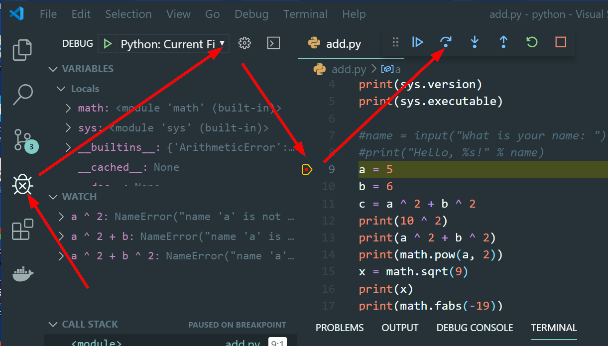
Debug

Slide 39
Unit Test
calc.py
def add(a, b):
return a + b
def sub(a, b):
return a - b
def multi(a, b):
return a * b
def divid(a, b):
return a/b

Slide 40
Unit Test
test_calc.py
import unittest
import calc
class TestCalc(unittest.TestCase):
def testAdd(self):
self.assertEqual(calc.add(10, 3), 13)
def testSub(self):
self.assertEqual(calc.sub(10,3), 7)
Do It by Yourself:
Add more test on these two calculation;
Do the unit test on other two math

Slide 41
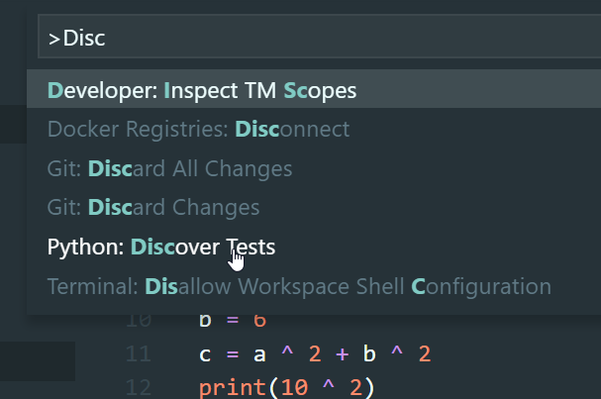
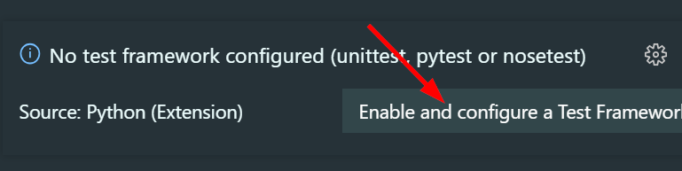
Unit Test

